Slide 1

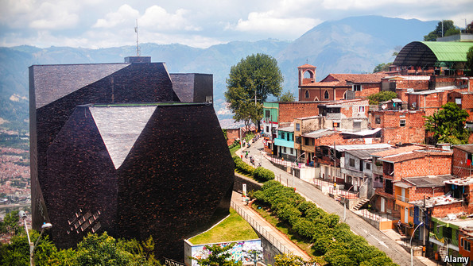
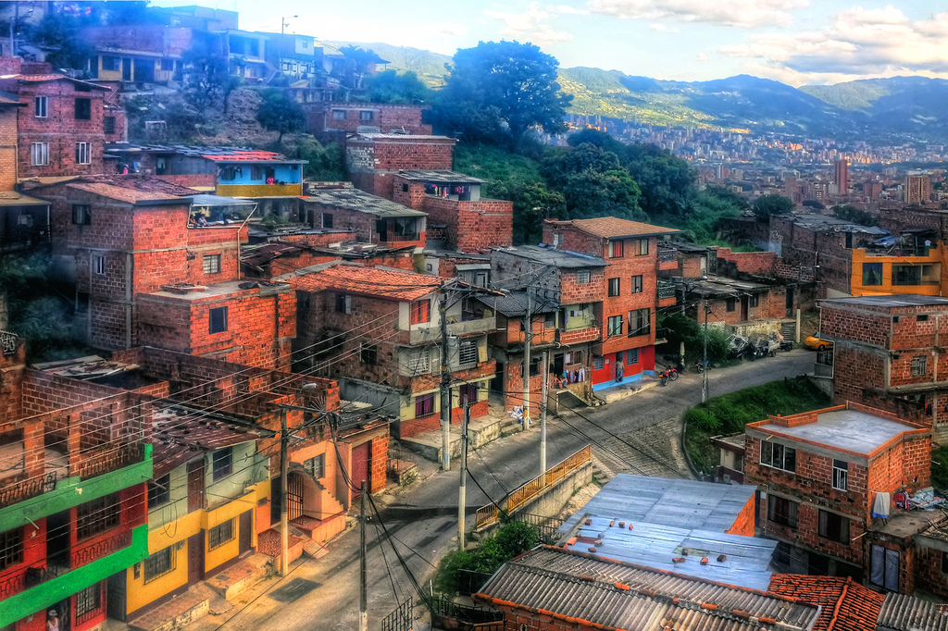
Richard Huber
Department of Sustainable Development
Sustainable Cities of the Americas –
Technologies to reduce Carbon
Trinidad and Tobago -- December 3, 2014

Slide 2
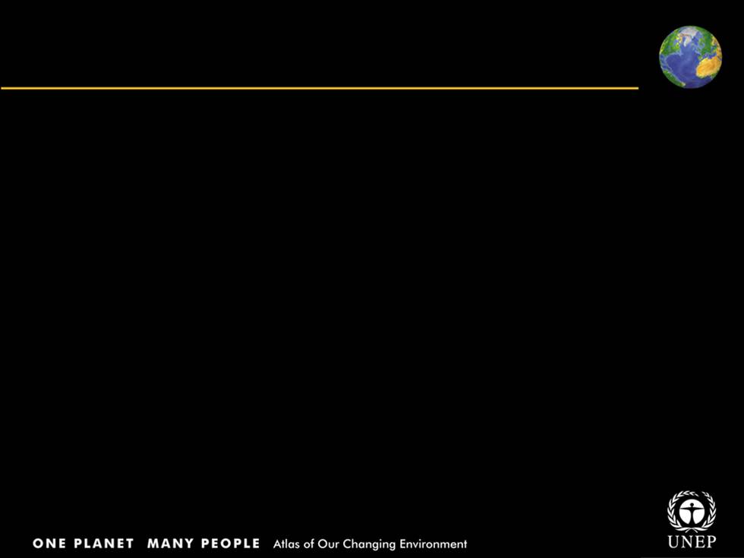

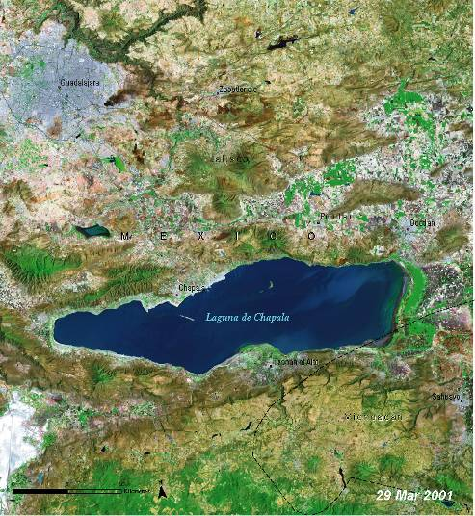
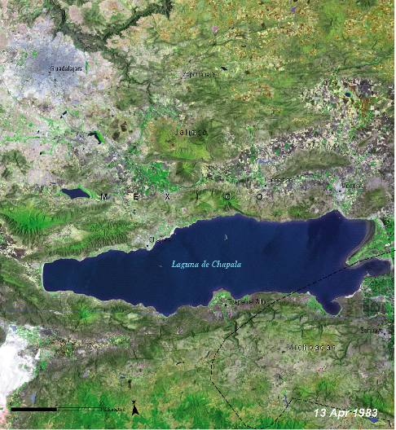
Mexico’s largest natural lake –
Lake Chapala, Mexico
1983: Level of the lake has declines; noticeable decreases in wetlands
2001: Alteration in the contours of the shoreline is clearly visible
Notes:
Mexico’s Lake Chapala, lying in the heart of an extremely arid region, is the country’s largest natural lake. The lake is one of the most important wetlands in the region and home to more than 70 endemic species. Since the 1950s, Lake Chapala has undergone many changes as a result of water abstraction for agricultural use both inside and outside the region and for a rapidly growing population. The level of the lake has declined, and there have been noticeable decreases in surrounding wetland areas as well as changes in the hydrological system connecting various springs. Some of these changes are visible in this pair of satellite images, including alterations in the contours of the shoreline, obvious extensions of land near various townships around the lake, and the appearance of remarkably large areas of reclaimed land at the lake’s eastern end. Like all arid areas, the land around Lake Chapala is prone to salinization. If the lake continues to shrink, researchers predict both a decrease in water availability and an increase in the salt content of the region’s soil.

Slide 3

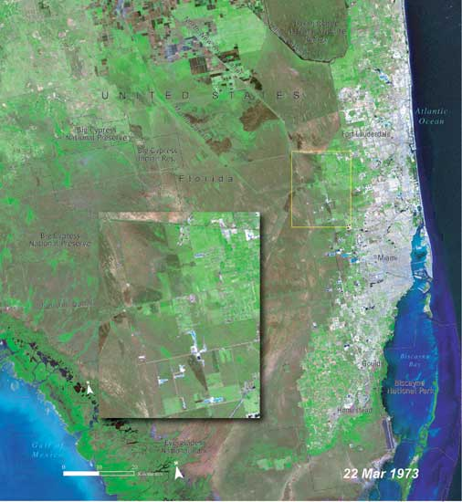
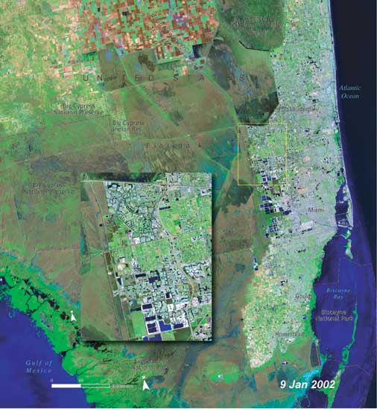
Natural Capital Degradation -- Urban encroachment on Florida’s Everglades, US
1973: Rapid urban expansion has converted farmlands to cityscapes
2002: Existence of vast wetlands “Everglades” threatened by urban encroachment
Notes:
These two Landsat images of southern Florida in the United States reveal some of the changes that have occurred in this region over the past 30 years. One of the most obvious is the growth of the Fort Lauderdale- Miami urban area. Urban version of what were once farmlands to cityscapes. The city of Miami has also expanded greatly to the southwest. The advance of urban areas westward across the peninsula threatens the continued existence of the vast wetlands area known as the Everglades. The Everglades ecosystem naturally filters groundwater and helps to recharge the Biscayne Aquifer. It is also home to a remarkable collection of plants and animals for which southern Florida is famous. As urban areas encroach upon the Everglades, water resources and wildlife habitat are placed at serious risk. Protecting the Everglades to maintain its essential water filtering capacity and remarkable biodiversity is part of the mission of the Federal “Smart Growth” Task Force, which is working to better manage urban sprawl and its negative consequences.

Slide 4

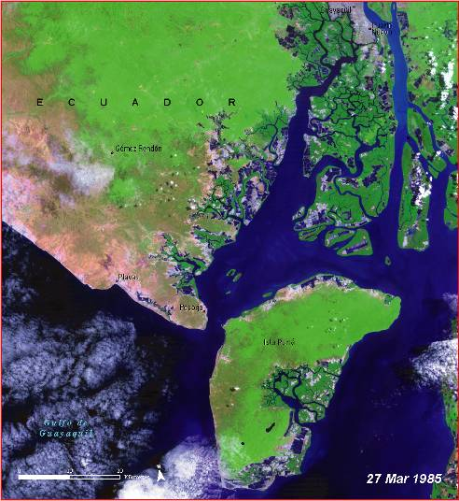
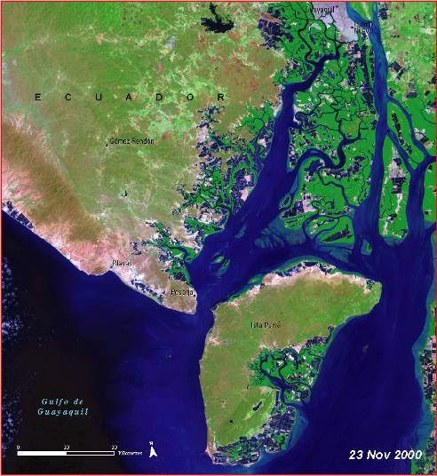
Changes in Ecuador’s largest sea port: Gulf of Guayaquil, Ecuador
Ecuador’s primary city and largest sea port
1985-2000: Loss of mangrove and growth of aquaculture can be seen
Notes:
Guayaquil is Ecuador’s largest city and primary sea port. It is located on the Guayas
River, which empties into the huge Gulf of Guayaquil along the country’s southern coastline. Throughout the Gulf, mangroves have been steadily converted to shrimp aquaculture ponds for producing farmed shrimp. In a 15-year period, coastal area developed for shrimp aquaculture grew by approximately 30 per cent, from 90 000 hectares (222 395 acres) in 1984 to 118 000 hectares (291 584 acres) in 2000 (CLIRSEN 2000). Roughly 70 per cent of Ecuador’s shrimp farming activities are located in the Gulf of Guayaquil. In this pair of satellite images, the loss of mangroves and growth of the aquaculture industry can be seen along the coast and in the altered dendritic patterns (branching like a tree) of coastal waterways, especially those on the large island of Puna. Mangroves provide fish breeding grounds and wildlife habitat, act as natural barriers against storm surge, and filter groundwater. Converting mangroves to aquaculture ponds has wide-reaching environmental implications.

Slide 5

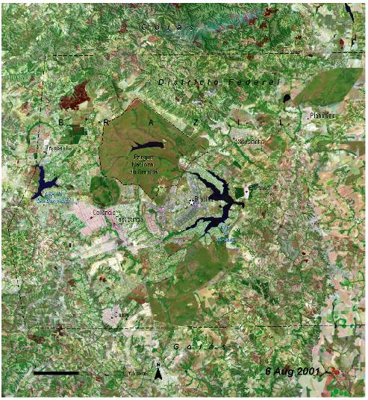
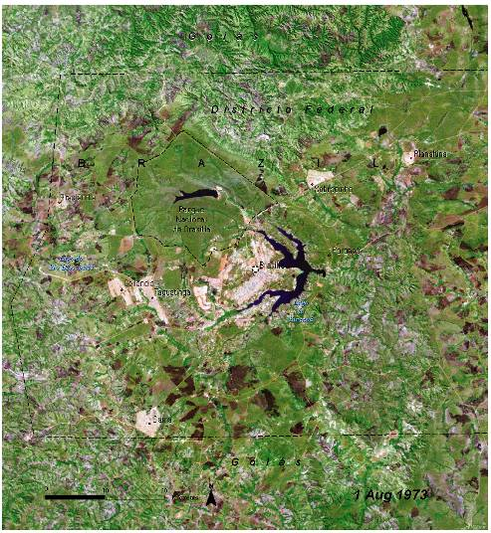
Unplanned growth of Brasilia, Brazil
1973-2001: Unplanned urban development resulted in a collection of urban “satellites” around the city
Notes:
Inaugurated on 21 April 1960, Brazil’s new capital of Brasilia began with a population of 140 000 and a master plan for carefully controlled growth and development that would limit the city to 500 000. Urban planner Lucio Costa and architect Oscar Niemeyer intended that every element—from the layout of the residential and administrative districts to the symmetry of the buildings themselves— should act in harmony with the city’s overall design. This consisted of a birdshaped core with residential areas situated between the encircling “arms” of Lake Paranoá. The city was a landmark in town planning and was recognized as a World Heritage site in 1987. As these images reveal, unplanned urban developments arose at Brasilia’s fringes resulting in a collection of urban “satellites” around the city. Several new reservoirs have been constructed since Brasilia’s birth, but the National Park of Brasilia stands out as a densely vegetated expanse of dark green that has remained relatively unchanged. In 1970, the population of Brasilia and its satellites was roughly 500 000. The population now exceeds 2 000 000.

Slide 6
Charles Dickens: the world today is “experiencing the best of times, and the worst of times.”
As a whole, humanity has achieved unparalleled prosperity;
Great strides are being made to reduce global poverty;
Technological advances are revolutionizing our lives, stamping out diseases, and transforming communication.

Slide 7
Development Divide
Source: The World Bank 2006

Slide 8
Inequality remains stubbornly high
LAC most urbanized region with 80% of population living in urban areas gernerating 75% OF CO2
growing global population — set to reach nearly nine billion by 2040 — is subjecting the natural environment to growing stress.
By 2030 “the world will need at least 50 percent more food, 45 percent more energy, and 30 percent more water —
all at a time when environmental limits are threatening supply.” Source: Resilient People, Resilient Planet 2012

Slide 9
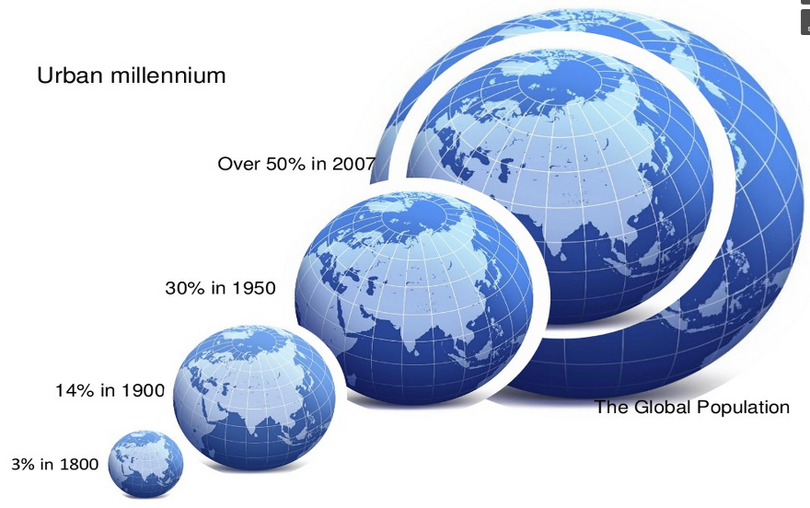
Urban Millennium

Slide 10



Latin America
3/4 parts of its population lives in cities
The largest cities in LA will generate 65% of its economic growth over the next 15 years.
LA top 7 cities, according to the latest population census, are mega-cities:
Challenges
City Administration
Quality and efficiency of services
Sustainable Development
Efficient resource management
Improvement of the quality of life
City | Population
Mexico City | 22,681.726
Sao Paulo | 20,534.112
Buenos Aires | 14,542.532
Rio de Janeiro | 12,058.824
Lima | 9,450.585
Bogotá | 8,493.675
Santiago | 7,003.122

Slide 11

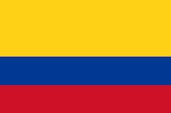

Best Practices in Latin America
Medellín Smart City, Colombia:
Beyond the public private partnership
Outstanding Project
“RUTA N"
Corporation created by the city of Medellin and UNE EPM.
Mission: To promote the development of innovative technology-based businesses that increase the competitiveness of the city .
Medellin Smart City is the program of the Mayor of Medellín and UNE EPM.
Beyond of the infrastructure provision: Open Gov, Citizen Participation, Social Innovation and Sustainability.
Strategic Pillars:
  Ownership
  Contents
  Strategic Innovation
  Public Communication
Key Lessons
Beyond the typical public private partnership for infrastructure.
Creation of a Corporation for the promotion of technology based businesses.
Political leadership. – Citizen oriented
Long-term political vision.
Evaluation tools.
Notes:
Más allá de la infraestructura
Gobierno abierto
La estrategia de gobierno abierto de Medellín Ciudad Inteligente está enfocada en la generación, promoción y posicionamiento de los datos abiertos (open data). Estamos convencidos de que la información generada por la Administración Municipal, otros entes estatales, la empresa privada y la academia debe estar libre y disponible para el uso y aprovechamiento de los ciudadanos.
Participación ciudadana
Generar una cultura de la participación a través de espacios adecuados para la misma es un elemento indispensable de una ciudad inteligente. Este programa está comprometido con propiciar estos espacios, visibilizar las propuestas de los habitantes de Medellín y lograr que las mismas tengan un efecto visible en las políticas públicas de la ciudad.
Innovación social
La capacidad de los individuos y las comunidades de transformar autónomamente sus propias realidades es una fuerza social invaluable que se ha potenciado gracias a las tecnologías de la información y la comunicación. En Medellín Ciudad Inteligente observamos cómo los ciudadanos están modificando su entorno, entendiendo sus particularidades y en ocasiones extrapolando soluciones para encontrar respuestas a la medida a nuestros propios problemas.
Sostenibilidad
Una buena relación con nuestro entorno garantiza desarrollo y calidad de vida, por eso estamos convencidos de que todos los esfuerzos encaminados a la generación de la ciudad inteligente deben estar acompañados de un nuevo paradigma en el cual las comunidades armonicen sus acciones y su forma de vida con el medio ambiente.
PILARES ESTRATÉGICOS
Pilar de Apropiación
El acercamiento a las comunidades, la sensibilización frente a los recursos que la ciudad ofrece y la inclusión digital son un insumo básico para el empoderamiento de la ciudadanía y el diseño de soluciones pertinentes para los habitantes de Medellín. El pilar de Apropiación asume estos retos vitales para la construcción de una ciudad inteligente.
Pilar de Contenidos
El componente de Contenidos y servicios, le ofrece a la ciudadanía información complementada con herramientas en línea de última generación. El canal primario de este pilar es el portal Medellín Ciudad Inteligente, a través del cual se pretende potenciar la relación de los medellinenses con su entorno a través de información pertinente y servicios eficientes.
Pilar de Innovación Estratégica
En Medellín Ciudad Inteligente, el ciudadano se convierte en el centro de todas nuestras actividades. Es por ello que el Pilar de Innovación Estratégica desarrolla proyectos sociales, interfaces inteligentes y servicios digitales pensando siempre en los ciudadanos de Medellín, colaborando con el desarrollo social y construyendo la ciudad inteligente con la que todos soñamos.
Pilar de Comunicación Publica
Para garantizar la participación de la ciudadanía en la construcción de la estrategia Medellín Ciudad Inteligente, es vital la visibilización de los esfuerzos que se están realizando tanto desde el Programa como desde la ciudadanía. El pilar de Comunicación Pública está centrado en la generación de identidad y compromiso con la ciudad inteligente a través de herramientas comunicativas presenciales y virtuales.
11

Slide 12
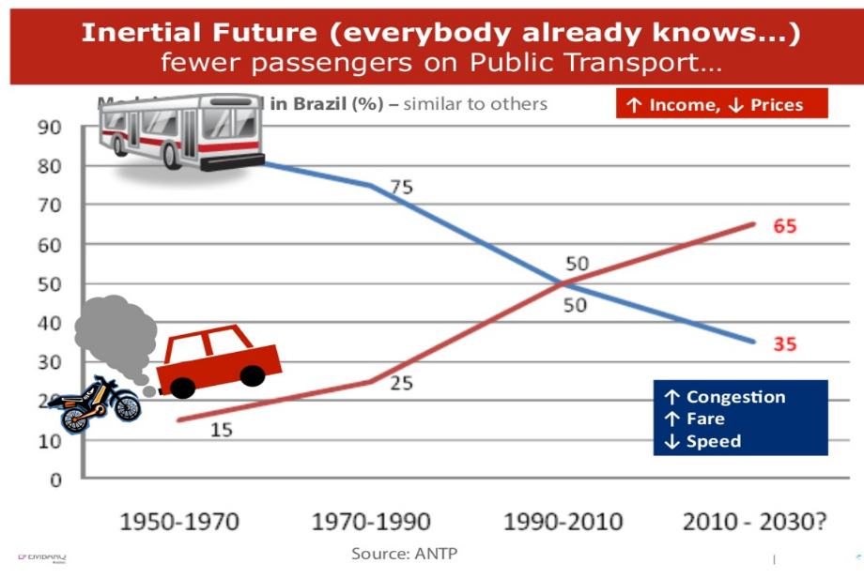
Source: Embarq, WRI

Slide 13
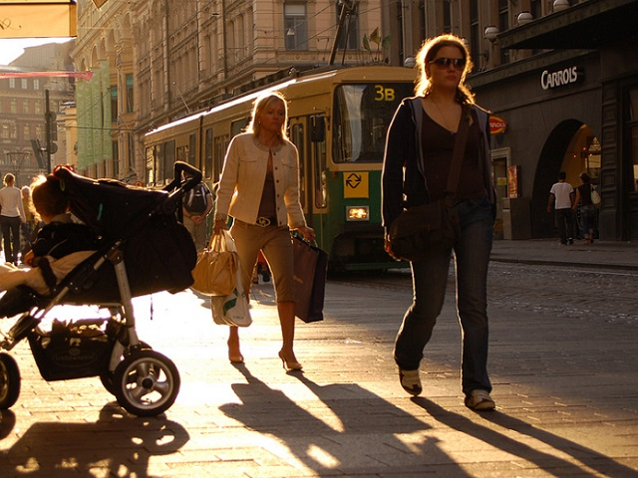
Helsinki, Finland plans to eliminate cars by 2025 -- future of sustainable urban mobility?

Slide 14
What can human-centered design thinking do for sustainable transport?
Car-sharing has proliferated, with membership rates increasing five-fold between 2006 and 2012 to 1.8 million members;
More than 600 cities have bike-sharing programs;
Car-free streets are the latest rage, from India’s car-free Raahgiri Days, to 295 pedestrian streets in Istanbul, to Helsinki’s car-free city movement;

Slide 15
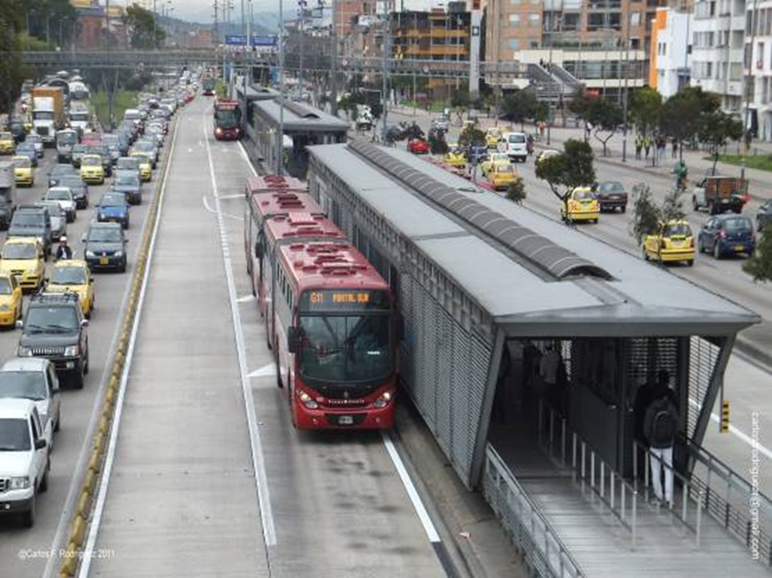
Three Steps for POS?is to:
Expand the Priority with TransMillenium brt
Avoid: Avoid or Reduce trips through the integration of land use and transportation planning
Shift: to more environmentally friendly modes, such as public transport, walking and bicycling
Improve: vehicle and
fuel technology of all
transport modes
for environmental
efficiency from each mile
traveled.

Slide 16
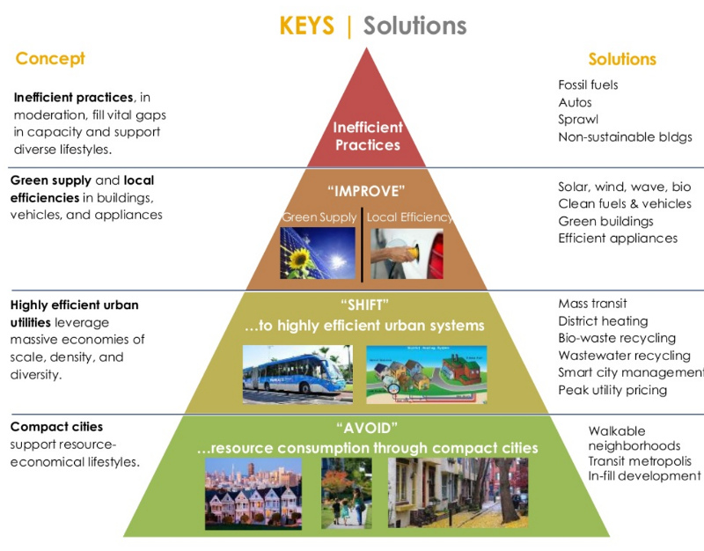
Rethinking Urban Development

Slide 17
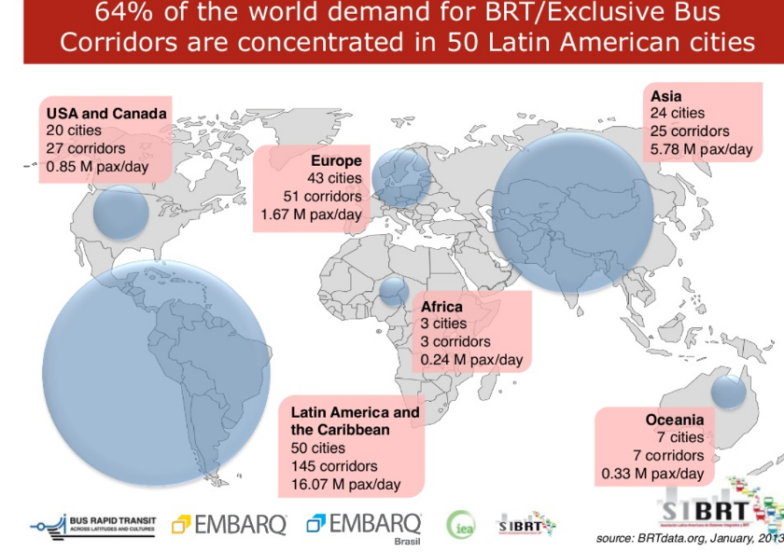
Source: Embarq, WRI

Slide 18

Bus Rapid Transit
In Colombia, the Transmilenio is a successful bus rapid transit program spreading to Brazil, Mexico, Guatemala, Ecuador, and beyond.

Slide 19
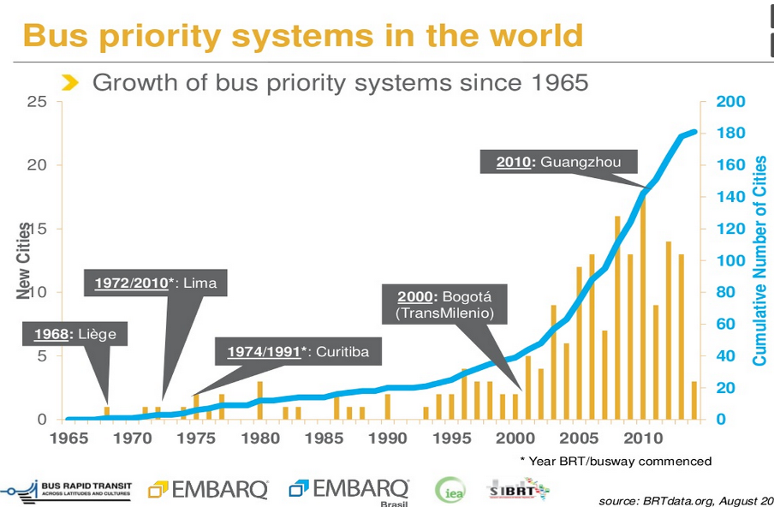

Slide 20
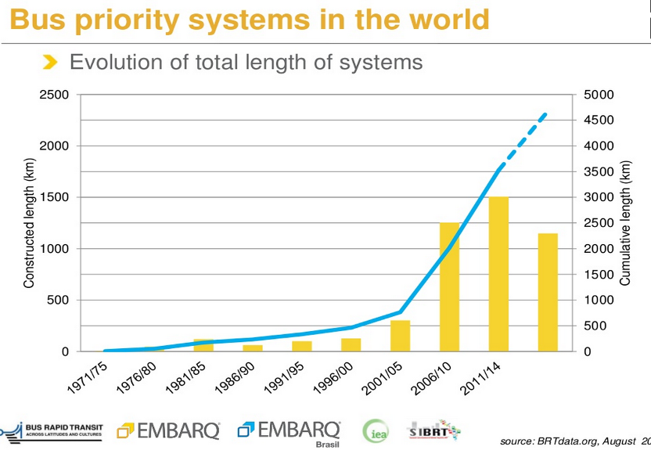

Slide 21
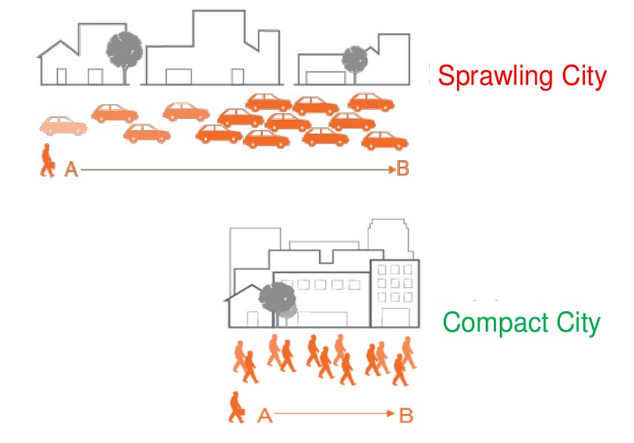
We have a choice

Slide 22
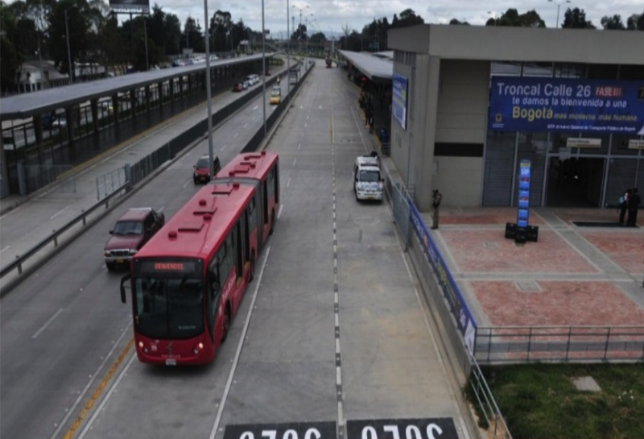
Bogota: Transmilenio Third Phase
Portal El Dorado

Slide 23
Bus Rapid Transit
In Colombia, the Transmilenio is a successful bus rapid transit program spreading to Brazil, Mexico, Guatemala, Ecuador, and beyond.

Slide 24
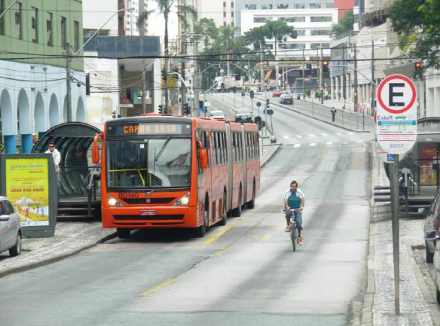

Slide 25
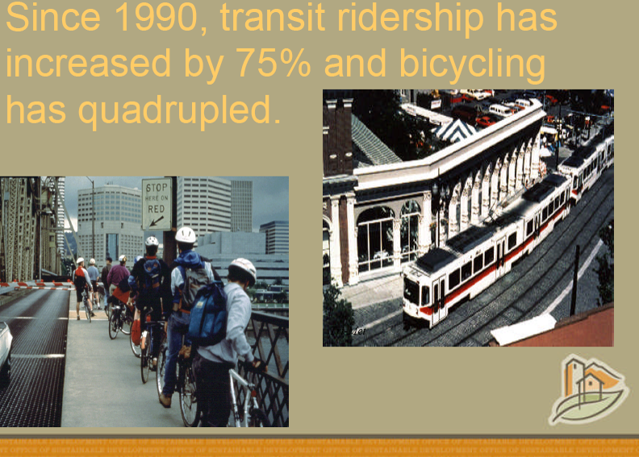

Slide 26
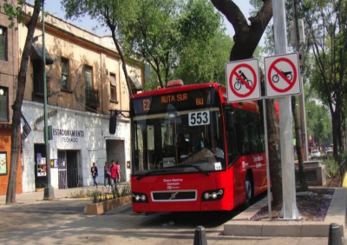
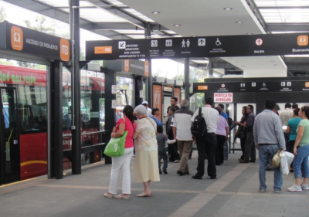
Mexico DF: Metrobus Line 4
Dedicated, confined bus lanes
Enclosed stations
Electronic fee payment prior to boarding
Large Buses, either articulated or bi-articulated
Advanced control systems to regulate times between buses overcrowding
Distinctive Image

Slide 27
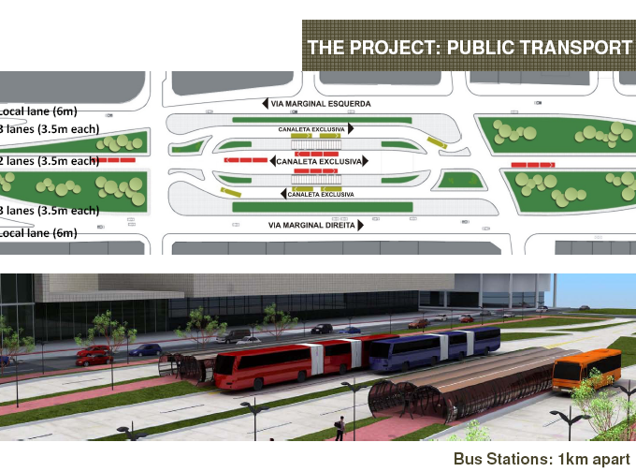

Slide 28
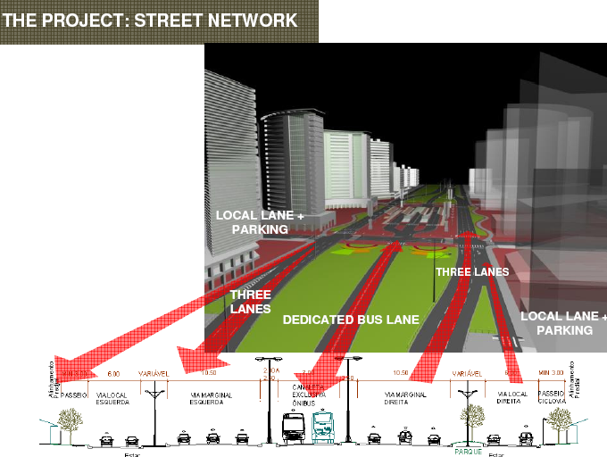

Slide 29
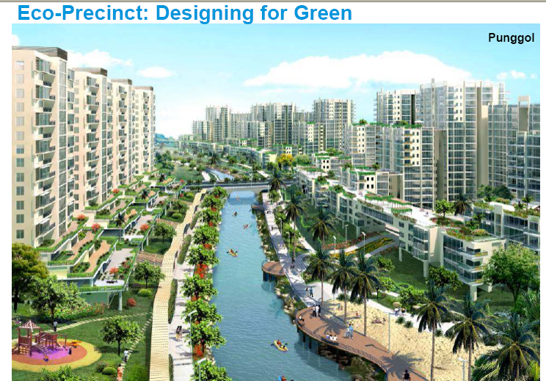

Slide 30
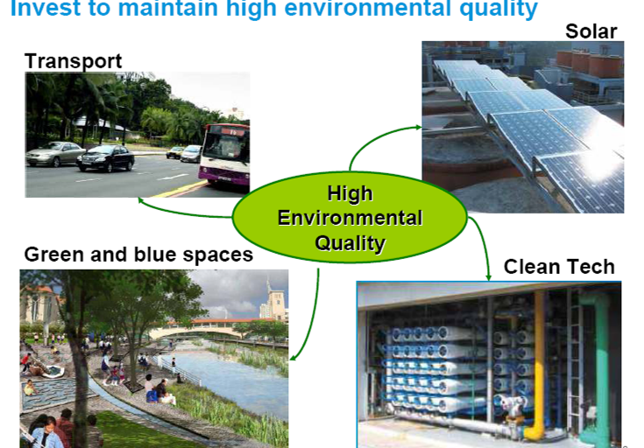

Slide 31
Sustainability -- So what is happening in the LAC
Low carbon Economies: Barbados, Belize, and Trinidad Tobago recognize the dangers of global warming and the importance of reducing the country's carbon footprint. Green Barbados, a target goal of the 2007 - 2025 National Strategic Plan, seeks to transform the country into a cleaner, more environmentally advanced country. In Belize City, advances in a Waterfront Development Strategy and Fort Point Pedestrian Walk are underway, and in T&T has initiated The Green Fund.
City government of Buenos Aires has launched a comprehensive bicycle program. As examples, in Brazil, programs are underway in Rio, Belo Horizonte, and Sao Paolo.
In Bogota, Colombia, the Transmilenio is a successful bus rapid transit program that is spreading to Cartegena.
Mexico City launched its first public bike share program, Ecobici, in February 2010. The system, which features 1,114 bikes and 85 stations, is part of the new Bicycle Mobility Strategy of Mexico City, which seeks to raise the number of cyclists in the city from one to five percent by 2012.
In Guadalajara, the 16-kilometer Macrobus program was inaugurated in March 2009 to be expanded to a 72-kilometer network by 2012.
Modernizing Public Transport transforming public transport systems to better serve the needs of their populations and the environment.

Slide 32
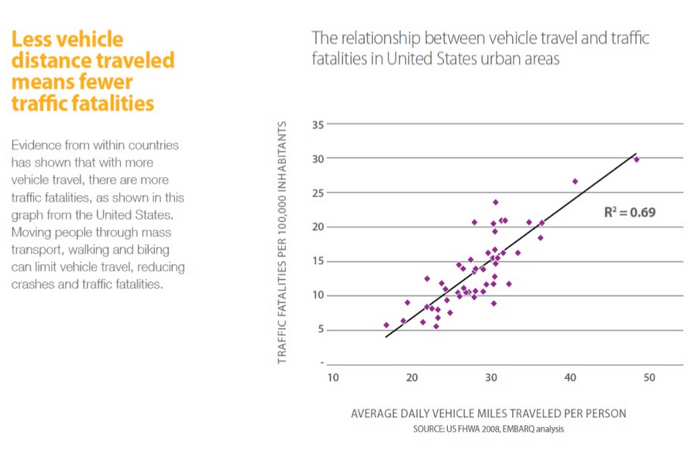
Vehicle travel and traffic fatalities

Slide 33
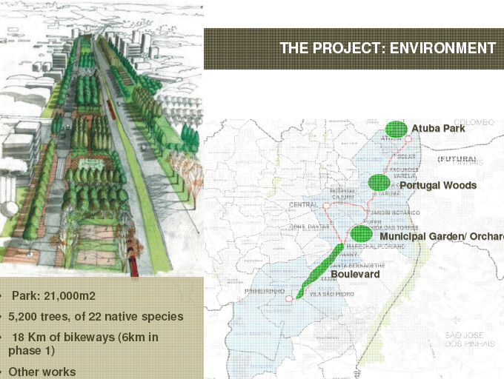

Slide 34
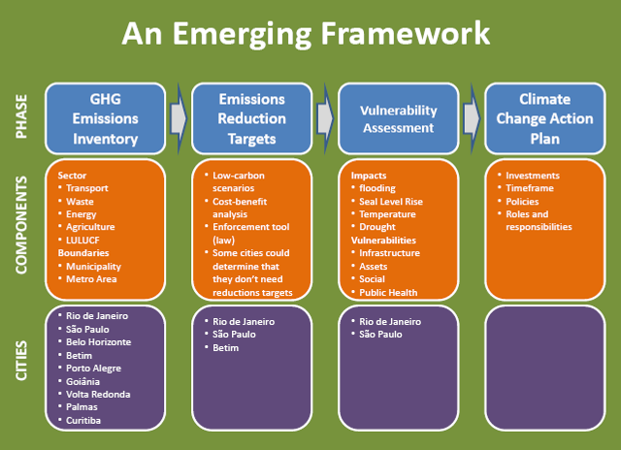

Slide 35
Environmental Policy Instruments Based on Decentralization & Flexibility Less participation More participation civil society
<---Minimum Flexibility---> <-- Moderate Flexibility ----> <--- Maximum Flexibility ------>
<--- Maximum Government Involvement ---> <--- Increased Private Initiative --->
<-Control-Oriented-> <----------Market-Oriented-------------> <-Litigation-Oriented->
Regulations and Sanctions | Charges, Taxes & Fees | Market Creation | Final Demand Intervention | Liability Legislation
Specific Examples of Urban Applications
Land use restrictions Construction impact regulations for roads, pipelines, ports, or communications grids Environmental guidelines for urban road alignments | Greening of conventional taxes e.g. Carbon tax Tolls and User charges for roads Congestion tax or fee Gas guzzler tax for cars that get less than 30 mph Tax break for buying a car that pollutes less or gets high MPG | Tradable permits for taxis Market-based expropriation for construction, including “environmental values” Tradable permits for air pollution emissions such as limiting taxis in urban center | Consumer product labeling (eco-labels) for hybrid vehicles and high MPG cars Education regarding recycling and reuse Disclosure legislation requiring manufacturers to publish gas mileage Blacklist of cars Ecotourism | Sue Ministry of Environment for not upholding their laws on air and water pollution and emission standards. Damages compensation “Zero net impact” requirements for road alignments, pipelines or utility rights of way, and water crossings

Slide 37

The New Model:
Multiple Agents, Multiple Incentives
State
Markets
Community
Notes:
PRDEI, December 18, 1996
Joining Communities and Markets to the State produces a new model of pollution regulation. In a world of multiple agents and multiple incentives, we must rethink the regulator’s appropriate role in pollution management. No longer is this role confined to producing, monitoring and enforcing rules and standards. Instead, the regulator can gain leverage through non-traditional programs which harness the power of communities and markets. There is ample room for information-oriented approaches such as voluntary participation/compliance programs and public disclosure of factories’ environmental performance. A broader implication is that one size no longer ‘fits all’ for regulatory policy design: Optimal combinations of regulatory tools will depend on country-specific social, economic and institutional conditions.

Slide 38
State
Regulators
The Law
Plants
Regulatory Standards
Market-based Instruments
Legal Liability
Notes:
PRDEI, December 18, 1996
In the traditional understanding of pollution control issues, the State holds center stage. Two principal agents -- Regulators and The Law -- are expected to set and enforce rules of environmental behavior. In keeping with this understanding of the problem, the policy analysis literature has focused on appropriate roles for ‘ex ante’ regulation (standards vs. market-based instruments) and ‘ex post’ liability claims by injured parties.

Slide 39
…and Other Actors are Important
Power
Social Norms
Negotiations
Plants
Citizens
Community
NGOs
Notes:
PRDEI, December 18, 1996
Recent evidence from Asia, Latin America and North America suggests that neighboring communities can have a powerful influence on factories’ environmental performance. Communities which are richer, better educated, and more organized find many ways of enforcing environmental norms. Where formal regulators are present, communities use the political process to influence the tightness of enforcement.
Where formal regulators are absent or ineffective, ‘informal regulation’ is implemented through community groups or NGOs. The agents of informal regulation vary from country to country -- local religious institutions, social organizations, community leaders, citizens’ movements or politicians. Factories negotiate directly with local communities, responding to social norms and/or explicit or implicit threats of social, political or physical sanctions if they fail to reduce the damages caused by their emissions.

Slide 40
Reputation
Profits
Plants
Consumers
Markets
Investors
Notes:
PRDEI, December 18, 1996
Factories operate in local, national and international markets, where many agents can affect revenues and costs. Environmental considerations now affect the decisions of these agents. In both industrial and developing countries, environmentalism in the middle and upper classes is a significant factor in consumer decisions. The importance of investor interest has also increased, with the growth of new stock markets and the internationalization of investment. Public knowledge a firm’s environmental performance may translate to large expected gains or losses over time.

Slide 41
The New Model:
Multiple Agents, Multiple Incentives
State
Markets
Community
Notes:
PRDEI, December 18, 1996
Joining Communities and Markets to the State produces a new model of pollution regulation. In a world of multiple agents and multiple incentives, we must rethink the regulator’s appropriate role in pollution management. No longer is this role confined to producing, monitoring and enforcing rules and standards. Instead, the regulator can gain leverage through non-traditional programs which harness the power of communities and markets. There is ample room for information-oriented approaches such as voluntary participation/compliance programs and public disclosure of factories’ environmental performance. A broader implication is that one size no longer ‘fits all’ for regulatory policy design: Optimal combinations of regulatory tools will depend on country-specific social, economic and institutional conditions.

Slide 42
Policy Experiment
PROPER
Indonesia’s Public Disclosure Program
Notes:
PRDEI, December 18, 1996
Case 2: Indonesia’s Public Disclosure Program
The China case demonstrates that capacity-building and improvement in analytic capabilities can contribute to the revision of existing policy instruments and the promotion of broader policy dialogue. Our second case, Indonesia’s PROPER program, demonstrates that the same approach can be used to promote experiments with entirely new policies.
PROPER is Indonesia’s innovative program for reducing pollution by rating and publicly disclosing the environmental performance of industrial facilities. We have participated in the development and assessment of PROPER, in a partnership with Indonesia’s National Pollution Control Agency (BAPEDAL) and the Bank’s Indonesia Country Department (EA3). PROPER has been particularly interesting because it is the first program of its kind in the world.

Slide 43
A⁺
5 Color Scheme for Green
Performance
A
B
D
F
Notes:
PRDEI, December 18, 1996
In PROPER, a polluter is assigned a color rating based on BAPEDAL’s evaluation of its environmental performance. A Blue rating is given to factories which are in compliance with national regulatory standards; Gold is reserved for world-class performers; and Black is assigned to factories which have made no attempt to control pollution and are causing serious damage. Intermediate ratings are Red, for factories which have some pollution control but fall short of compliance; and Green, for factories whose emissions control and housekeeping procedures significantly exceed those needed for compliance.

Slide 44
PERFORMANCE LEVELS
PERFORMANCE CRITERIA
Clean technology, waste minimization, pollution prevention, conservation, etc.
GOLD
Above standards & good maintenance, housekeeping, sludge management, etc.
GREEN
BLUE
Efforts meet minimum standards
RED
Efforts don’t meet standards
Purple
No pollution control effort,
Serious environmental damages

Slide 45
INCENTIVES
GOLD
Public Praise
GREEN
BLUE
RED
Public Pressure &
Legal Enforcement
BLACK
Notes:
PRDEI, December 18, 1996
As an incentive program, PROPER reflects traditional practice by penalizing non-compliance with regulatory standards. However, it moves beyond compliance-based regulation by rewarding superior performance. It improves BAPEDAL’s information by encouraging good performers to identify themselves. It also encourages them to help BAPEDAL identify poor performers, since the latter have a competitive advantage as long as they can avoid pollution control costs.

Slide 46
Eco efficiency
Voluntary Performance
Information &
Ratings
Reputation
& Profits
Social Pressure
& Local
Enforcement
Markets
Community
Notes:
PRDEI, December 18, 1996
Why might PROPER be expected to have a significant impact on pollution? We turn to our ‘regulatory triangle’ model for some answers. First, while we have noted the importance of community influence on polluters’ behavior, our findings also suggest that inadequate information may distort communities’ perceptions of their pollution problems. For example, attention may be focused on emissions which are easy to see (or smell), rather than those which are truly harmful. Public disclosure of factory-specific ratings by BAPEDAL offers significant empowerment to local communities in this context. Secondly, PROPER brings market forces to bear on polluters by providing appropriate information on factories’ environmental performance to consumers and investors.

Slide 48
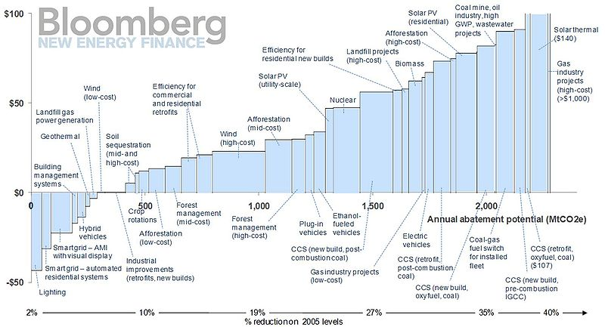

Slide 49
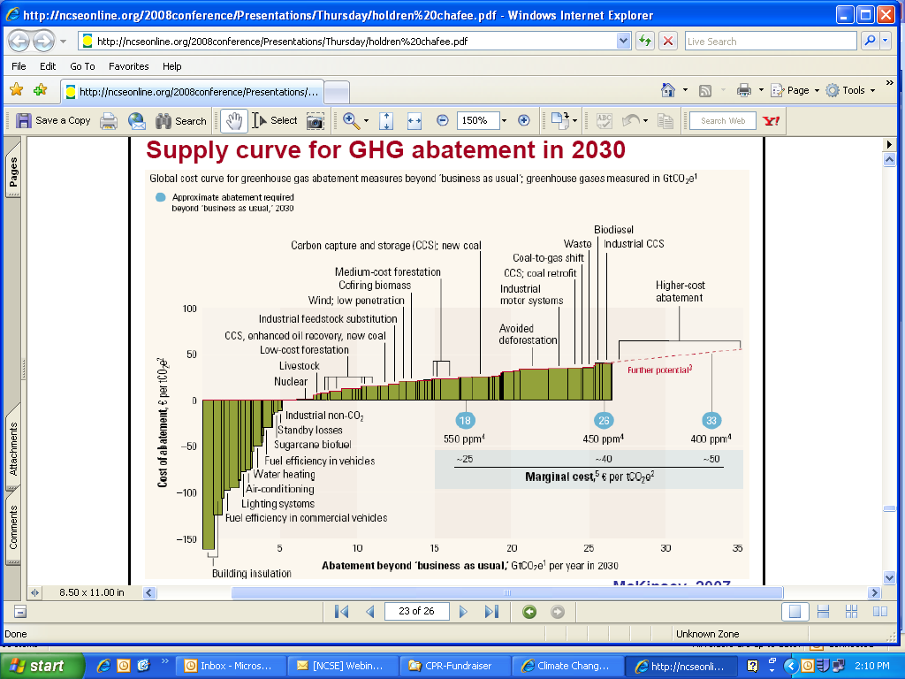

Slide 50
GLOBAL LEVEL: Carbon Marginal Abatement Curves:
Abatement cost
€ per tCO₂e
Gas plant CCS retrofit
Coal CCS retrofit
60
Low penetration wind
Iron and steel CCS new build
Plug-in hybrid cars
Coal CCS new build
50
Residential electronics
Power plant biomass co-firing
Residential appliances
Degraded forest reforestation
Reduced intensive agriculture conversion
40
Nuclear
Retrofit residential HVAC
Pastureland afforestation
High penetration wind
30
Tillage and residue mgmt
Degraded land restoration
Solar PV
20
Insulation retrofit (residential)
2nd gen. biofuels
Solar CSP
Cars full hybrid
Building efficiency new build
10
Waste recycling
0
5
10
15
20
25
30
35
38
-10
Organic soil restoration
Abatement potential
GtCO₂e per year
-20
Geothermal
Grassland management
-30
Reduced pastureland conversion
Reduced slash and burn agriculture conversion
-40
Small hydro
-50
1st generation biofuels
Rice management
-60
Efficiency improvements other industry
Electricity from landfill gas
-70
Clinker substitution by fly ash
-80
Cropland nutrient management
Motor systems efficiency
-90
Insulation retrofit (commercial)
-100
Lighting – switch incandescent to LED (residential)
50
Global GHG Abatement Cost Curve v2.0 (2010): McKinsey & Company
Notes:
MAC curve for the electricity sector for the Nicaraguan communities of Orinoco and Marshall Point, with respect to a diesel carbon price of 396 $/tCO₂.
50

Slide 51
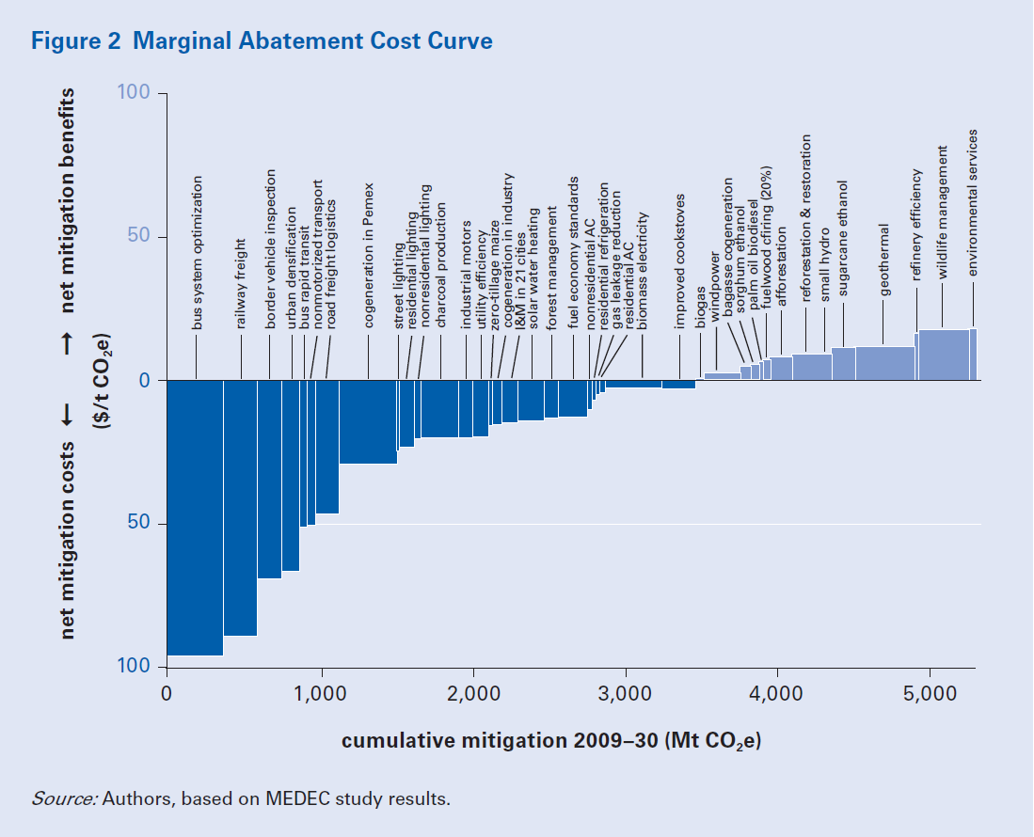
COUNTRY LEVEL: Carbon Marginal Abatement Curves:
MEXICO
51
JJohnson, et al., Low-carbon study for Mexico (2010): The World Bank
Notes:
MAC curve for the electricity sector for the Nicaraguan communities of Orinoco and Marshall Point, with respect to a diesel carbon price of 396 $/tCO₂.
51

Slide 52
Solid Waste Management
Cities currently generate 1.3 billion tonnes of solid waste/year
With current urbanization trends, this figure will grow to 2.2 billion tonnes/year by 2025: an increase of 70 %.
Waste management also represents a great opportunity for cities.
Managed well, solid waste management practices can reduce greenhouse gas emission levels in a city.
Notes:
Solid waste is mostly an urban phenomenon. In rural communities there are fewer packaged products, less food waste and less manufacturing. A city resident generates twice as much waste as their rural counterpart of the same affluence. If we account for the fact that urban citizens are usually richer, they generate four times as much.
Ask a mayor of a developing country city about his or her most pressing problems, and solid waste management generally will be high on the list. For many cities, solid waste management is their single largest budget item and largest employer.
It is also a critical matter of public health, environmental quality, quality of life, and economic development. A city that cannot effectively manage its waste is rarely able to manage more complex services such as health, education or transportation. And no one wants to live in a city surrounded by garbage.

Slide 53
Practical Approaches to
Waste Management in LAC Cities
Public education
To inform people about their options to reduce waste generation and increase recycling and composting;
Pricing mechanisms
(such as product charges) to stimulate consumer behavior to reduce waste generation and increase recycling;
User charges tied to the quantity of waste disposed of
Consumers separating recyclables paying a lower fee for waste disposal; and/or
Preferential procurement policies and pricing
To stimulate demand for products made with recycled post-consumer waste.
Notes:
http://siteresources.worldbank.org/INTURBANDEVELOPMENT/Resources/336387-1334852610766/Chap7.pdf

Slide 54
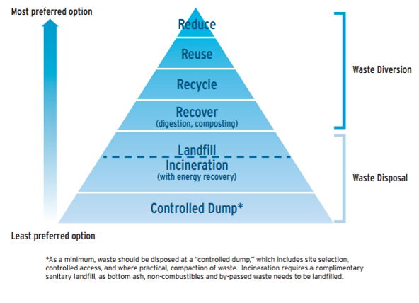
Waste Hierarchy
Notes:
http://siteresources.worldbank.org/INTURBANDEVELOPMENT/Resources/336387-1334852610766/Chap7.pdf

Slide 55
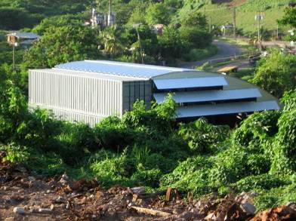
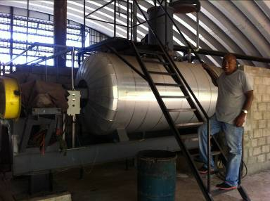
The
OAS Sustainable Communities Project – US$2m in grants and policy initiatives
Grenada Project
Recycle waste streams including fish and other offals, brewer’s spent grain, market waste, restaurant and hotel food waste and crop waste to manufacture a protein product that will lower the cost of feeding poultry and significantly improve the livelihoods of Grenada’s farmers while avoiding putting noxious organic wastes in the local landfill and generating odor problems.

Slide 56
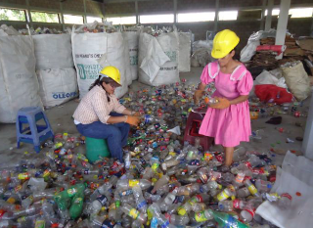
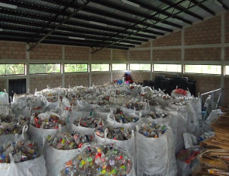
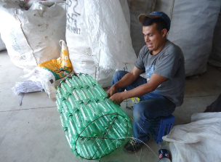
Hermandad de Honduras recycling project
Waste management system through a micro-enterprise model, creating jobs and opportunities for local residents, making waste collection cost effective, accessible and financially sustainable.

Slide 57

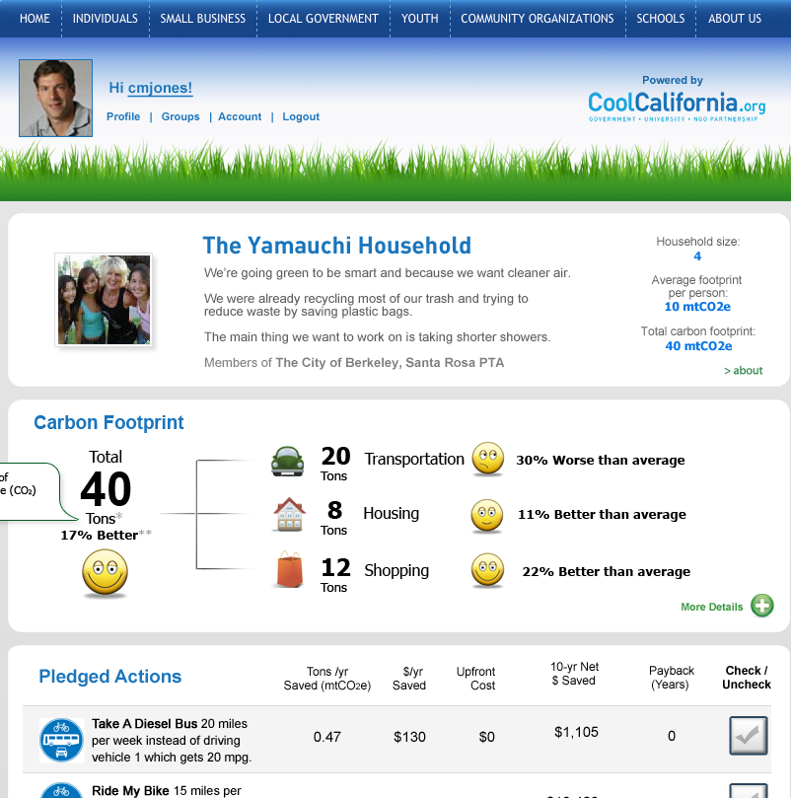

Tools to measure and manage
YOUR Carbon Footprint:
yourwebsite.org
Our website plugs into yours!
Carbon management tool & website free to all California local govts.
Plugs into any website
Hi Dan!
Benchmark carbon
footprint profiles of all U.S. zip codes, cities & counties
(custom reports available)
Compare carbon footprints, pledges, progress & more of cities, counties and groups
Live highlights of communities taking climate action, links to helpful resources, etc.
Compare carbon footprints, pledges & progress of members of each community
Carbon footprint profile pages
- See footprints, pledges, progress, & more…
Mia Yamauchi
Events & resources
local administrator
Contact the CoolClimate Network for more information: info@coolclimate.berkeley.edu

Slide 58
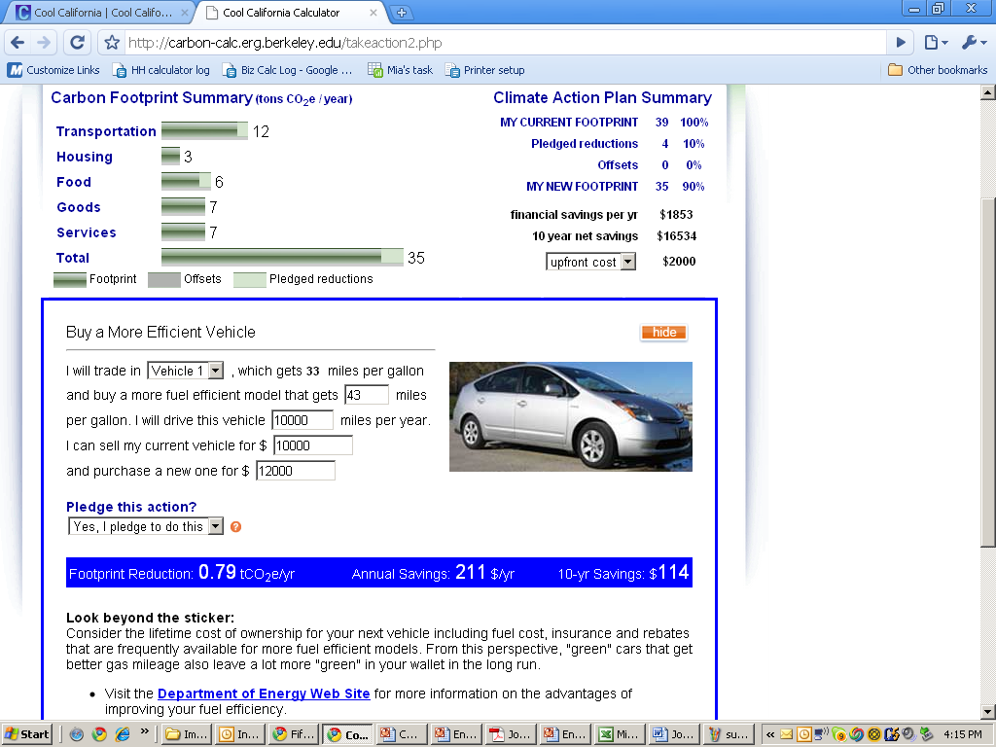
58
Notes:
58

Slide 59
Carbon footprint of average U.S. household
50 metric tons carbon dioxide equivalents (CO₂e) per year
source: coolclimate.berkeley.edu
59
Notes:
59
59

Slide 60
Carbon footprint of average California household
47 metric tons CO₂e per year
source: coolclimate.berkeley.edu
Previous studies:
Fuel processing
Fuel transport/storage
Power plant construction
Our study:
Procurement
Full supply chain LCA
energy indirect
60
Notes:
60
60

Slide 61
Carbon footprint of average St. Louis household
49 metric tons CO₂e per year
source: coolclimate.berkeley.edu
61
Notes:
61

Slide 62
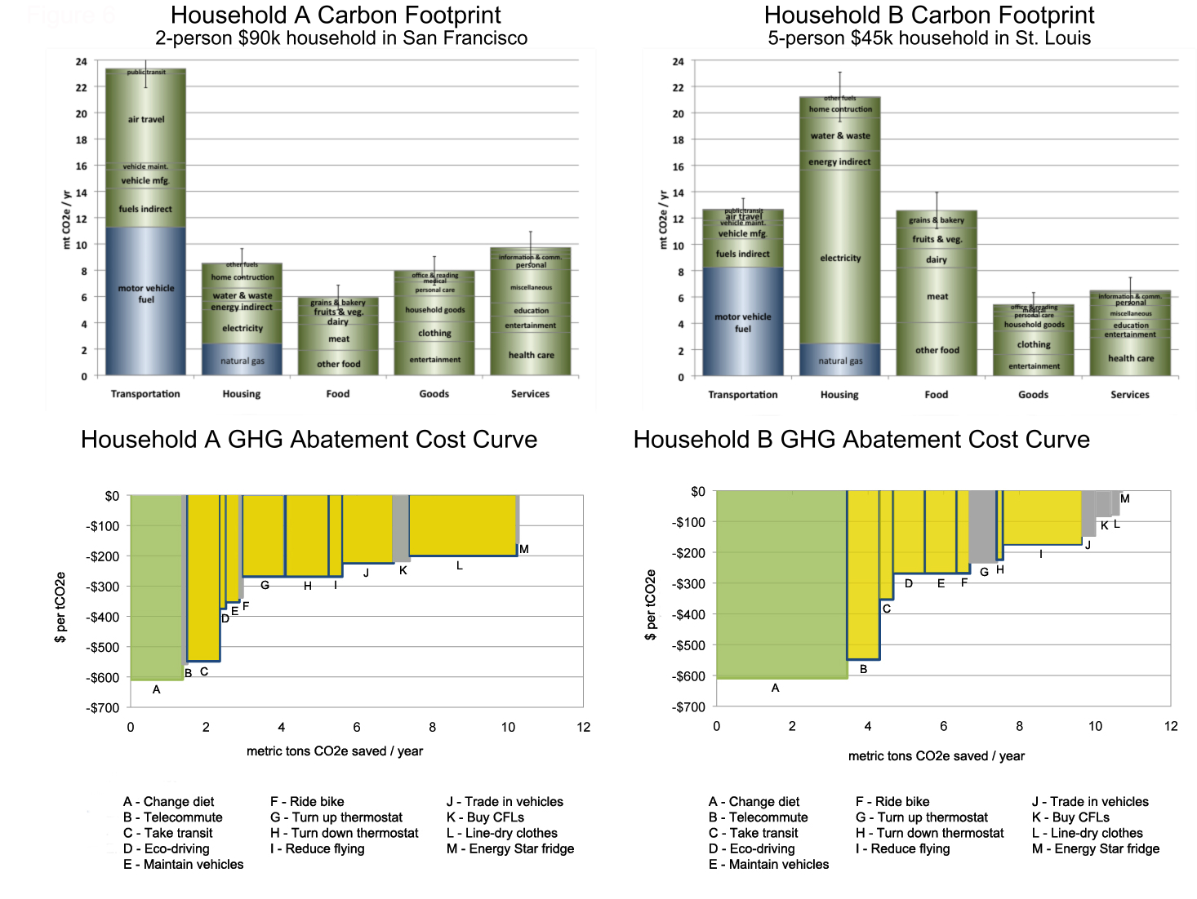
62
source: coolclimate.berkeley.edu
Notes:
62

Slide 63
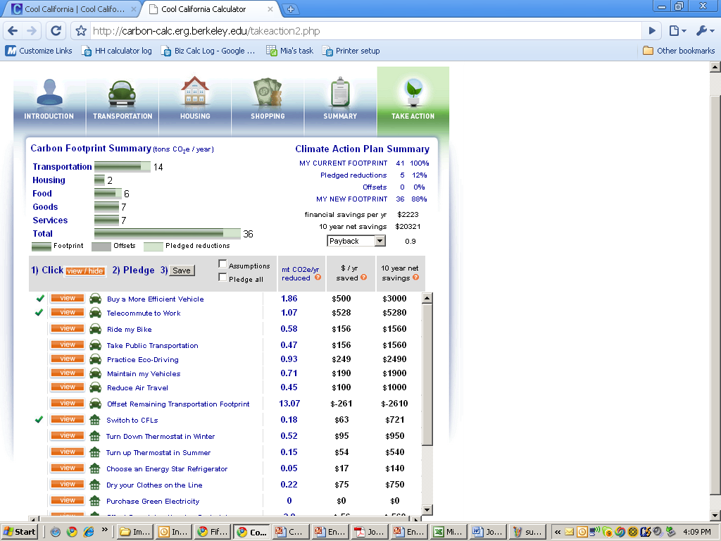
63
Notes:
63

Slide 64

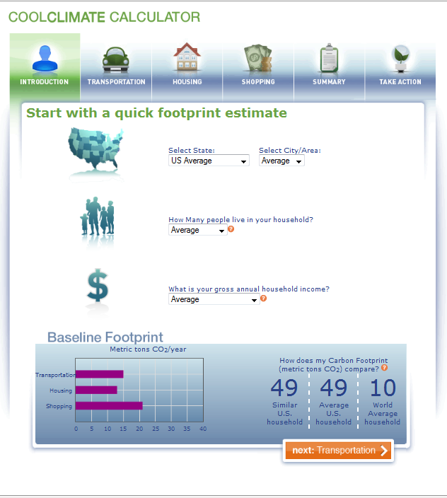
CARIBBEAN GREEN TECHNOLOGY CENTER
USVI HOUSEHOLD CARBON CALCULATOR
Governor's Goal: Reduce fossil fuel usage in the USVI by 60% by 2025
In 2010 began work with NREL and the University of the Virgin Islands to develop a household calculator for education purposes.
Based on the Cool Climate Carbon Footprint Calculator developed at RAEL
Expenditure Data
Consumer Expenditure Surveys and Consumer Price Index Data
Emissions Factors
Utilities: Electricity, Water, Gas, and Waste based on local Utility data
Food/Goods and Services: EIO-LCA data
Transportation: based on EIO-LCA data for vehicle manufacture, local data on taxi, ferry, and standard vehicle characteristics
http://www.eiolca.net/
http://coolclimate.berkeley.edu/
64
CARIBBEAN GREEN TECHNOLOGY CENTER, UVI … R. SHIRLEY, UNIVERSITY OF CALIFORNIA, BERKELEY … RENEWABLE AND APPROPRIATE ENERGY LABORATORY
Notes:
64

Slide 65
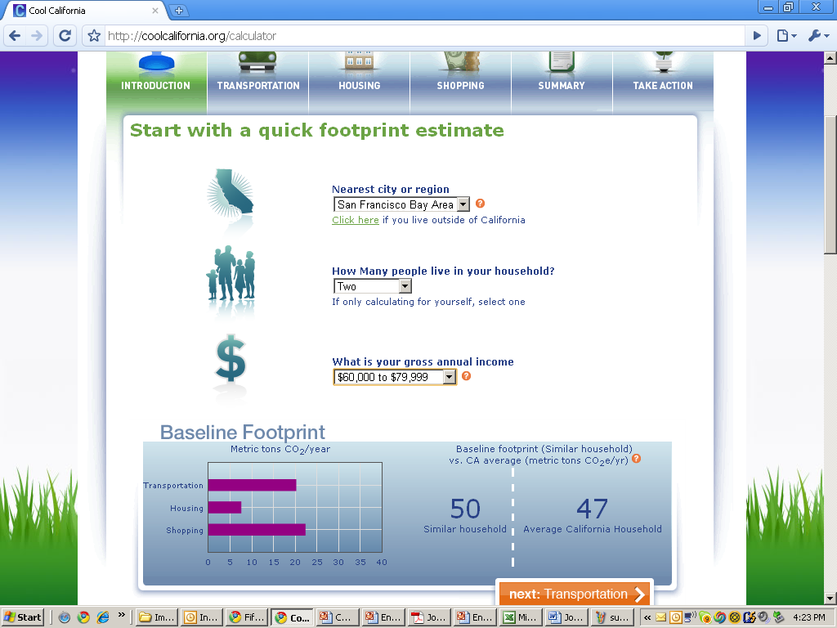
65
Notes:
65

Slide 66

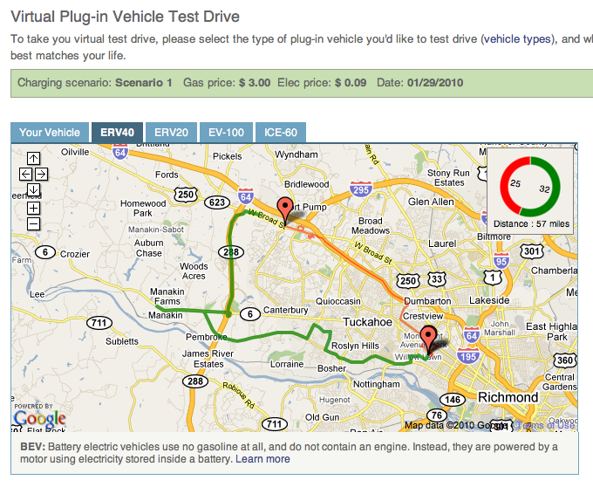
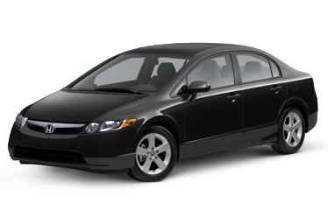

Integrating Energy and Information Technology: Virtual Test Drives
1
2
3
App runs AUTOMATICALLY | Drive your current car | Visit your Virtual Test Drive on the web
66
Notes:
At first, it seemed easy. Make a simple app that logs location every second as well as speed and acceleration events. Have the user turn on the app each time they get in the car. So we built it. And it didn’t really work. Because the user’s forgot. Even I forgot, and it’s my app.
The benefit of the network fleet device, and we had several running as well, is that the user could forget about it. We needed to replicate the same user experience with the phone. Luckily, new android and iOS4 opened a window to do that. Spent summer figuring out how to automate it. So now: download app, create an account, and forget about it (….). Drive as usual, app knows and turns on. The app gives you a few basic stats (distance today). When you get home, go online to see your data displayed and analyzed (I’ll take you through that in a moment).
It looks simple. But (STARS) figuring out the automation on the app in a way that maintained battery life was quite difficult. And, as you may know if you’ve worked with iPhones, the data is messy. We knew this from the beginning (iPhone = low fi) but it still takes a lot of cleverness and filtering to do things like lock to roads, figure out how to fill a gap if the phone connections blinks out for 2 minutes (which, if you have ATT in the Bay, you know it does). Also, with the automation, lots of misfires (turns on at the wrong time) and messy starts and ends. Have to filter out.
When we started the project, we thought the app data sending bit would be the easy part, and the interpretation of the data the challenge. We were wrong. But we’ve got a working prototype now, and it’s pretty cool.
66

Slide 67



Use Data to Create a VIRTUAL Test Drive
67
Notes:
So how do we get it. Create a drive cycle from data shows before. Then we feed that drive cycle into a simulation of a variety of electrified vehicles to see how they would perform under the same conditions. This take sinto account things that change range and efficiency, such as hills and aggressive driving style. (TAKE THROUGH EACH ONE)
CAVEATS: This is not accurate to within a 10th of a mile. When we get our hands on vehicles, we’ll do calibration and I will be able to tell you the standard average. But it’s not perfect, and it’s not supposed to be. Simluations we have plenty of work to go, automation needs to be taken into account, and we need to understand what this is. We know a lot about the leaf and the volt. But unless Nissan and GM give up their computer models, which they won’t, we’re not going to get a 100% accurate modeling. Some people come up and say: oh have you taken into account that Berkeley is 8 degrees colder than Stanford. No, because the impact of that type of temperature swing is smaller than the impact of the assumptions we have to make about the cars. We’d like to get there eventually!
More important: for the purpose of this tool, people don’t need that type of accuracy. Our system will warn people who are pushing limits not to. But it’s much more important to get that difference between the volt and the leaf, that understanding of the rhythm. Most
67

Slide 68







Games to Help the Planet
Games merged with websites, apps, competitions, and campaigns (on and offline)
Social games are very popular.
Social networks and individual game popularity change, but the networks and the types of games
remain popular.
Notes:
Games are not just games: Games are often merged with websites, apps, competitions, and campaigns (on and offline)
Social games are not new games: They are traditionally popular games that are either massively networked or played online with friends and family through social networking platforms.
Individual game popularity is volatile, but game category popularity is more stable.
“interactive applications and persuasive games”: The term that most correctly applies to what we are looking at here. This is the focus of Human Computer Interactions (HCI) and Ubiquitous Computing (UbiComp) experts focused on “eco-feedback” technologies.
** so, for purposes of this, we focus on mixed interactive apps and persuasive games that are social (or potentially so), as popular games today are generally played in some networked capacity. For this project, investigation of behavior change at both an individual and group level by way of game play naturally involves the ‘social game’.
68

Slide 69


All these games can earn you “Greenlight points”
Points can motivate just by being points…
or with intrinsic (driving related) prizes!
Luca
Morgan
Bernard
Raleigh, North Carolina
69

